Slide 1
NERC 的特征空间 —— Feature space for NERC
—— 杨尚斌

Slide 2

特征向量

Slide 3

Usually, the NERC problem is resolved by applying a rule system over the features

Slide 4
Example
recognition rule: capitalized words are candidate(候选) entities
classification rule: the type of candidate entities of length greater than 3 words is organization

Slide 5
However, real systems tend to be much more complex and their rules are often created by automatic learning techniques.

Slide 6
the features most often used
Word-level features
List lookup features
Document and corpus features

Slide 7
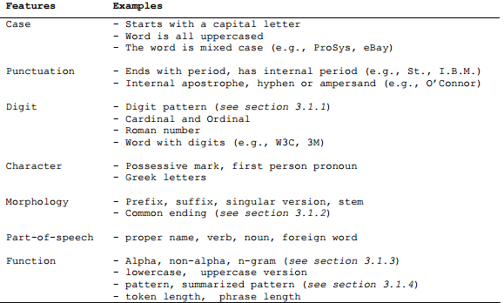
Word-level features

Slide 8
Word-level features —— Digit Pattern
dates, percentages, intervals, identifiers
two-digit and four-digit numbers can stand for years (1997、97)
when followed by an “s”, they can stand for a decade ( 1997s )
one and two digits may stand for a day or a month

Slide 9
Word-level features —— Common word ending
Morphological features are essentially related to words affixes and roots
a system may learn that a human profession often ends in “ist” ( journalist, cyclist )
languages often ends in “ish” and “an” ( Spanish, Danish, Romanian ).

Slide 10
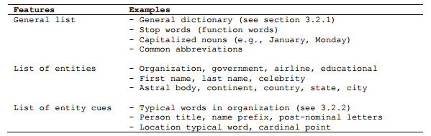
List lookup features

Slide 11
List lookup features
privileged features
Is a
Paris is a city

Slide 12
List lookup features —— General dictionary
Common nouns listed in a dictionary are useful

Slide 13
List lookup features —— Words that are typical of organization names
Many authors propose to recognize organizations by identifying words that are frequently used in their names
American
China

Slide 14
List lookup features —— On the list lookup techniques
Most approaches implicitly require candidate words to exactly match at least one element of a pre-existing list
Technology/technologies
Frederick/ Frederik
Lewinskey/ Lewinsky

Slide 15
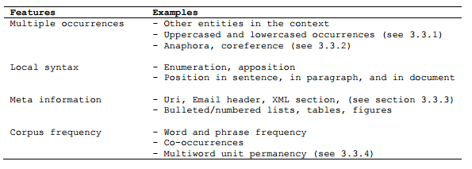
Document and corpus features

Slide 16
Document and corpus features
Document features are defined over both document content and document structure. Large collections of documents (corpora) are also excellent sources of features

Slide 17
Document and corpus features —— Multiple occurrences and multiple casing
appear both in ambiguous (e.g., sentence beginning) and unambiguous position
C. Thielen (1995), Y. Ravin and Wacholder (1996) and A. Mikheev (1999)

Slide 18
Document and corpus features —— Entity coreference ( 指代 ) and alias
The task of recognizing the multiple occurrences of a unique entity in a document dates back to the earliest research in the field
New York、New York Yankees
Sir John A. 12 Macdonald、John A. Macdonald、John Alexander Macdonald、Macdonald

Slide 19
Document and corpus features —— Document meta-information
Most meta-information about documents can be used directly
email headers are good indicator of person names
news often start with a location name,

Slide 20
Document and corpus features —— Statistics for Multiword units
propose some interesting feature functions for multi-word units that can be thresholded using corpus statistics
rare lowercased words
relatively long size

Slide 21
Thanks !

